Slide 1
COM1201-Fundermentals of Program design
programming paradigm

Slide 2
Sub Topics
What is programming paradigm
Categories of Program paradigm

Slide 3
Program paradigm?
A programming paradigm refers to a style or approach to programming.
It provides a methodology and structure for solving problems using a programming language

Slide 4
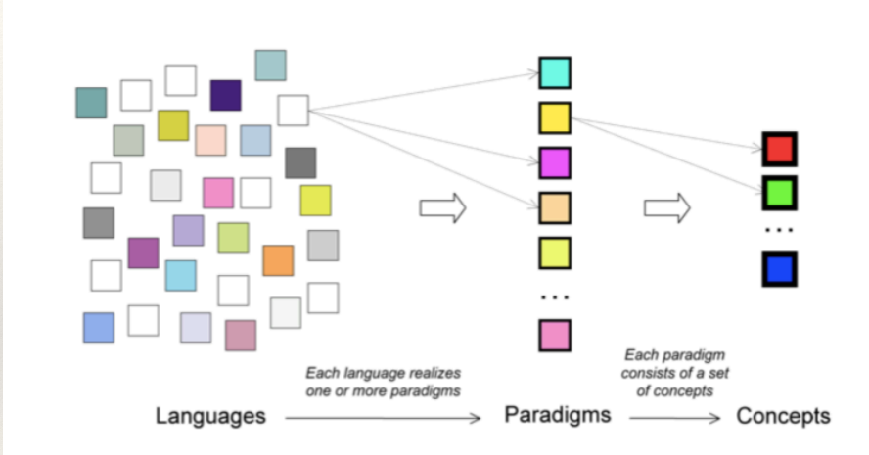

Slide 5
Why programming paradigms??
Choosing the Right Approach for a Problem
Efficient Problem Solving
Better Code Organization and Maintainability
Adaptability Across Multiple Languages
Improves Collaboration
Boosts Learning New Languages
Promotes Innovation

Slide 6
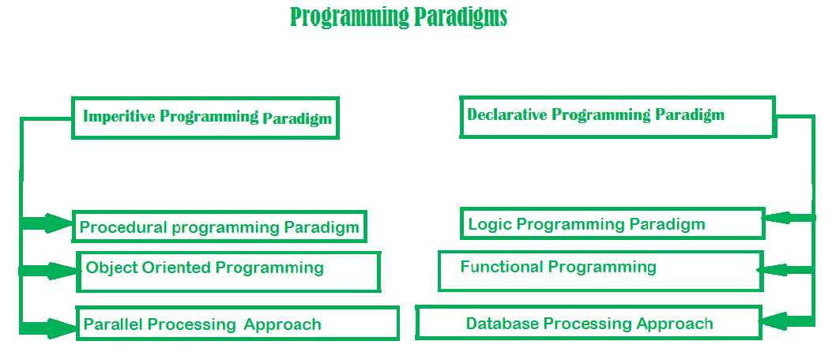

Slide 7
Imperative programming paradigm
The imperative programming paradigm is a style of programming where the developer writes sequences of instructions that explicitly tell the computer how to perform tasks.
It focuses on changing a program's state through statements that modify variables, control flow, and memory.

Slide 8
Key Characteristics
Step-by-Step Instructions: Specifies exact steps to solve a problem.
State Changes: Program state changes through variable updates.
Control Structures: Uses loops (for, while), conditionals (if-else), and functions.
Command-Driven: Commands are executed in a specific sequence.

Slide 9
Procedural programming paradigm
The Procedural Programming Paradigm is a subset of the Imperative Paradigm. It organizes code into reusable blocks called procedures or functions, making programs easier to manage, understand, and modify..
Examples of Procedural programming paradigm:
C : developed by Dennis Ritchie and Ken Thompson
C++ : developed by Bjarne Stroustrup
Java : developed by James Gosling at Sun Microsystems
ColdFusion : developed by J J Allaire
Pascal : developed by Niklaus Wirth

Slide 10
Object oriented programming
The Object-Oriented Programming (OOP) paradigm is a programming approach that models real-world entities using objects. It emphasizes organizing code into classes and objects to promote modularity, reusability, and scalability.
Advantages:
Data security
Inheritance
Code reusability
Flexible and abstraction is also present

Slide 11
Key concepts
Class
A blueprint for creating objects.
Defines attributes (data) and methods (functions).
Example: Car, Student, Employee.
Object
An instance of a class.
Represents a specific entity with defined properties and behaviors.
Encapsulation
Bundling data and methods into a single unit (class).
Protects data by restricting direct access (using private, public).
Inheritance
Allows a class (child) to inherit properties and behaviors from another class (parent).
Promotes code reuse and hierarchical relationships.
Polymorphism
The ability to process objects differently based on their data type or class.
Achieved through method overloading and overriding.
Abstraction
Hides complex implementation details and shows only the essential features.
Simplifies user interaction with objects.

Slide 12
Examples of Object Oriented programming paradigm
Simula : first OOP language Java : developed by James Gosling at Sun Microsystems C++ : developed by Bjarne Stroustrup Objective-C : designed by Brad Cox Visual Basic .NET : developed by Microsoft Python : developed by Guido van Rossum Ruby : developed by Yukihiro Matsumoto Smalltalk : developed by Alan Kay, Dan Ingalls, Adele Goldberg

Slide 13
Parallel processing approach
Parallel processing is the processing of program instructions by dividing them among multiple processors.
A parallel processing system posses many numbers of processor with the objective of running a program in less time by dividing them. C/C++ also supports because of some library function.

Slide 14
Declarative programming paradigm
It is divided as Logic, Functional, Database.
In computer science the declarative programming is a style of building programs that expresses logic of computation without talking about its control flow.

Slide 15
Logic programming paradigms
It can be termed as abstract model of computation. It would solve logical problems like puzzles, series etc. In logic programming we have a knowledge base which we know before and along with the question and knowledge base which is given to machine

Slide 16
Functional programming paradigms
The functional programming paradigms has its roots in mathematics and it is language independent. The key principle of this paradigms is the execution of series of mathematical functions.

Slide 17
Database/Data driven programming approach
This programming methodology is based on data and its movement. Program statements are defined by data rather than hard-coding a series of steps.
A database program is the heart of a business information system and provides file creation, data entry, update, query and reporting functions.

Slide 18
Review questions
List differences between procedural and object-oriented programming.
Difference between Functional Programming and Object Oriented Programming

Slide 19
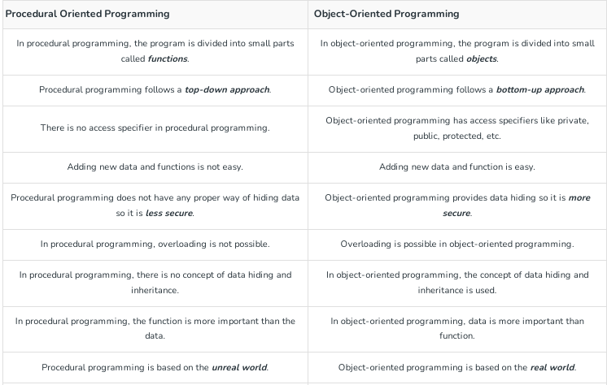

Slide 20
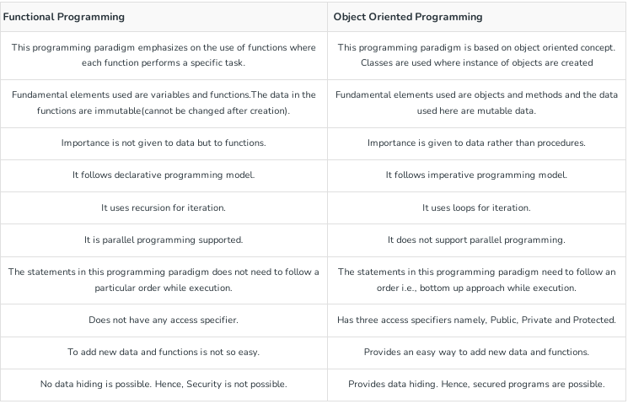

Slide 21
End

